Slide 1
Logic Synthesis For Low Power CMOS Digital Design

Slide 2
Outlines
Power consumption model
Reduction of output gate transitions
  i. Logic synthesis for low power
  ii. State assignment for low power
Turning-off portions of a circuit

Slide 3
Power Dissipation
Static dissipation due to leakage circuit
Short-circuit dissipation
Charge and discharge of a load capacitor
V_{DD}
o
V_{in}
V_{out}
GND

Slide 4
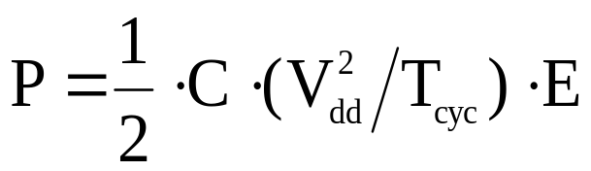
Power Dissipation Model
P: the power dissipation for a gate,
C: the load capacitance,
V_{dd}: the supply voltage,
T_{cyc}: the clock period,
E: the transition count of the gate per clock cycle.

Slide 5
How to Compute Transition Density?
signal probability P¹(g):
the probability of a logic 1 at the output of gate g
signal probability P⁰(g):
the probability of a logic 0 at the output of gate g, 1-P¹(g)
signal transition probability(density) P^{t}
0 1 or 1 0
i1
1
3
i2
4
5
i3
2
i4

Slide 6
Simulation-based Computation
Logic
Simulator
Logic waveform
of each node
Input-pattern dependent
Two many input patterns

Slide 7
Probability-based Computation
A simple method :
g
P⁰(g) =
P¹(g) =
P¹(i1)
P⁰(i1)
i1
i1
g
P¹(g) = P¹(i1) *P¹(i2)
P⁰(g) = 1-P¹(g)
P⁰(g) = P⁰(i1) *P⁰(i2)
P¹(g) = 1-P⁰(g)
i2
i1
g
i2

Slide 8
Probability-based Computation
A simple method :
i1
1
3
i2
4
5
i3
2
i4
Time
.....
t_{i}
t_{i+1}
.....
P⁰(e)
P¹(e)
P¹(e)
P⁰(e)
(1-P¹(g))*P¹(g) P¹(g)*(1-P¹(g))
=> 2*P¹(g)*(1-P¹(g))
Inaccuracy of the simple model
  Temporal relations
  Spatial relations

Slide 9
Technology Mapping For Low Power
a
Pt=0.109
b
G1
c
d
G3
out
e
G2
f
Pt=0.109
Pt=0.179
Pt=0.179
Pt=0.179
(a) Circuit to be mapped
Gate Type Area Intrinsic Input Load
Cap. Cap.
INV 928 0.1029 0.0514
NAND2 1392 0.1421 0.0747
NAND3 1856 0.1768 0.0868
AOI33 3248 0.3526 0.1063
(b) Characteristics of the Library

Slide 10
Technology Mapping For Low Power
AOI33
a
b
G1
INV
c
d
G3
out
e
G2
f
Area Cost: 4176
Power Cost: 0.0907
(c) Minimum-Area Mapping
NAND3
a
NAND2
WIRE
b
G1
c
d
G3
out
e
G2
f
NAND3
Area Cost: 5104
Power Cost: 0.0803
(d) Minimum-Power Mapping

Slide 11
State Assignment
01
-0
00
S₂
S₃
11
01
-0
1-
0-
10
-1
S₁
S₄
11
PI
PO
Combinational
Logic
v₁
u₁
PS
NS
v₂
u₂

Slide 12
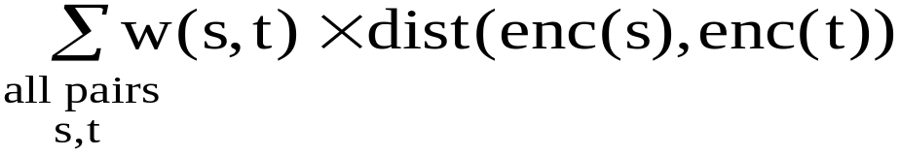
State Assignment for Low Power Design
Uneven distribution of state transitions in Finite State Machine
State assignment such that states with high transitions are given state codes of short distance
Minimize
  w(s,t): transition between s and t (power cost)

Slide 13
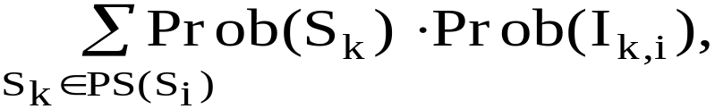
State Probability Model
I_{k,i}
S_{k}
S_{i}
Prob(S_{i}) =
where
PS(S_{i}) : the set of immediately previous
states of S_{i},
Prob(I_{k,i}): the probability of input pattern
I_{k,i}

Slide 14
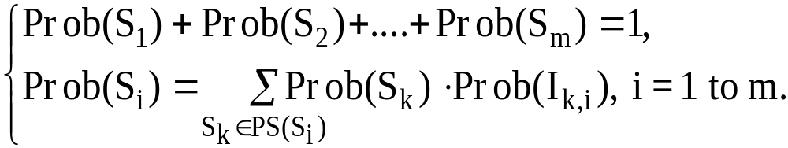
State Probability Model (cont.)
The summation of all states probability is equal to 1, therefore
The state probabilities of S_{i}’s can be obtained by solving the linear system using the Cholesky Decomposition method.

Slide 15






Partitioning of a Controller
Turning Off Portions of a Circuit
1/00
START
s4
0/00
0/00
M1
0/01
1/10
s6
0/10
1/01
1/10
s5
0/00
M2
1/10
00/0
s2
0/00
s7
1/00
1/00
s3

Slide 16
Four Questions:
1. How do we determine the submachine to be turned on in each clock cycle?
2. When an inactive submachine becomes active, how do we set it to the correct state for the next clock cycle?
3. How does an active submachine relinquish control and pass it to the submachine which will become active in the next clock cycle?
4. Physically, how do we turn off a piece of combinational logic?

Slide 17
Question 1
How do we determine which submachine to be turned on?
current state + input next state
the submachine to be turned on
To simplify the control logic:
state code:
  States in the same submachine will have the same control bits.
  The remaining bits will be used to distinguish among states in the same submachine.
need control logic to
make this decision
control bits

Slide 18
State Code of the Sub-machines
1/00
START
S4
0/00
0/00
M1
0/01
1/10
s6
0/10
1/01
1/10
s5
0/00
M2
1/10
00/0
s2
0/00
s7
1/00
1/00
s3

Slide 19
Question 2
When an inactive submachine becomes active, how do we set it to the correct state?
  Include the crossing transition in the state transition table of the submachine

Slide 20
An Example
M1
M2
s0
0
s3
0
1
1
s1
s4
0
s2
s5
1
M1
M2
input present state next state output
input present state next state output
0
1
0
1
0
1
s0
s0
s1
s1
s2
s2
s1
s3
s2
s3
s1
s5
1
0
1
0
1
1
0
1
0
1
0
1
s3
s3
s4
s4
s5
s5
s0
s1
s1
s5
s4
s3
1
0
1
0
0
0

Slide 21
Question 3
How does an active submachine relinquish control to allow another submachine to become active?
  The above state assignment will allow control to be transferred from one machine to another with no additional circuitry

Slide 22

Question 4
How we actually turn on and off a piece of combinational logic?
FF₁
FF₂
FF₃
control_1
1 2
decoder
e2
X1
X1
e1
A
B
C
D
E
F
G
H
Com_1(M 1)
Com_2(M 2)
mux_1
2 1
mux
mux_2
2 1
mux
mux_3
2 1
mux
mux_4
2 1
mux
mux_5
2 1
mux
O1
O2

Slide 23
Two Subproblems to Solve
1. Partitioning a Finite State Machine into submachines
2. State assignment for submachines

